Slide 1


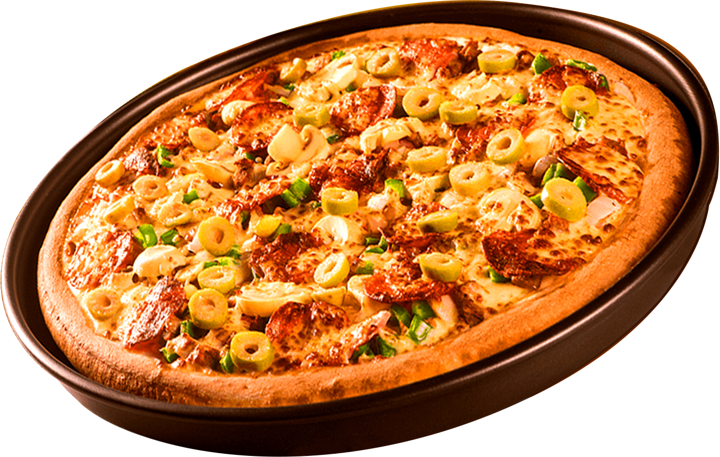

PIZZA SALES
NEXT >

Slide 2

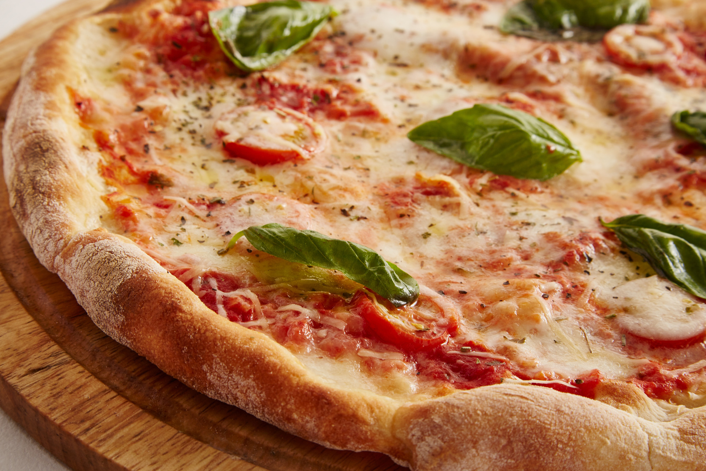
ANALYSIS OF PROBLEM
The objective of this presentation is to provide a comprehensive analysis of pizza sales data to identify key trends, customer preferences, and revenue drivers. The insights aim to support strategic decision-making for:
Enhancing Sales Performance: Highlighting top-performing pizzas and identifying areas for improvement.
Optimizing Operations: Uncovering peak order times and aligning inventory and staffing with demand.
Maximizing Revenue: Evaluating pricing strategies and recommending adjustments to boost profitability.
Understanding Customer Preferences: Analyzing popular categories and ingredients to refine the product offering.
< BACK
NEXT >

Slide 3
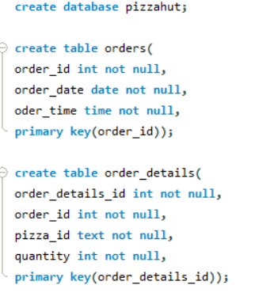
< BACK
NEXT >

Slide 4
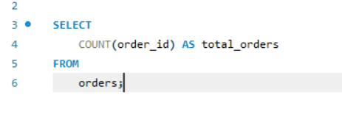
Retrieve the total number of orders placed.
< BACK
NEXT >

Slide 5
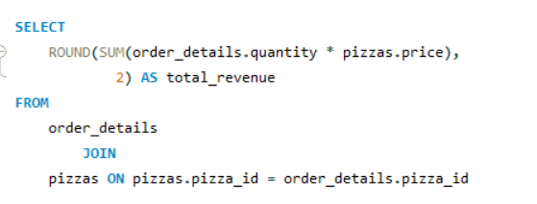
2. Calculate the total revenue generated from pizza sales.
< BACK
NEXT >

Slide 6
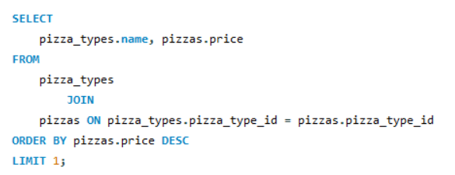
3. Identify the highest-priced pizza.
< BACK
NEXT >

Slide 7
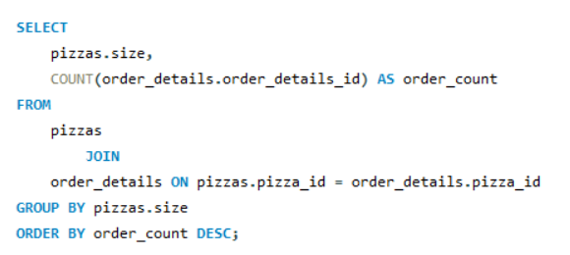
4. Identify the most common pizza size ordered.
< BACK
NEXT >

Slide 8
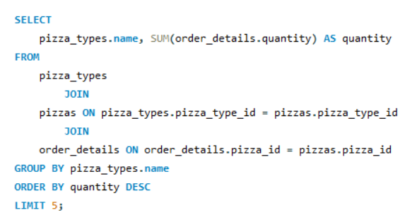
5. List the top 5 most ordered pizza types along with their quantities.
< BACK
NEXT >

Slide 9
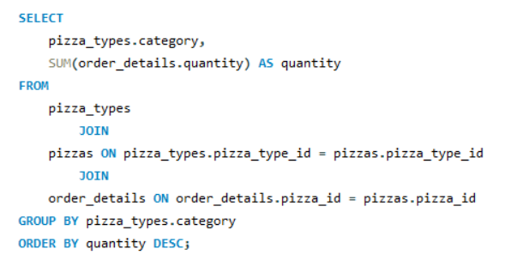
6. Join the necessary tables to find the total quantity of each pizza category ordered.
< BACK
NEXT >

Slide 10
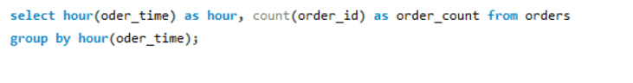
7. Determine the distribution of orders by hour of the day.
< BACK
NEXT >

Slide 11
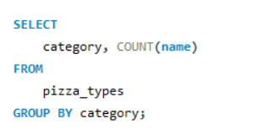
8. Join relevant tables to find the category-wise distribution of pizzas.
< BACK
NEXT >

Slide 12
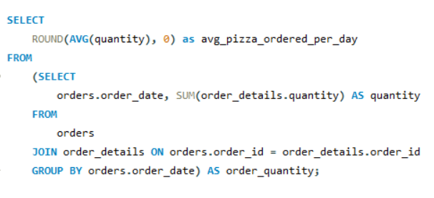
9. Group the orders by date and calculate the average number of pizzas ordered per day.
< BACK
NEXT >

Slide 13
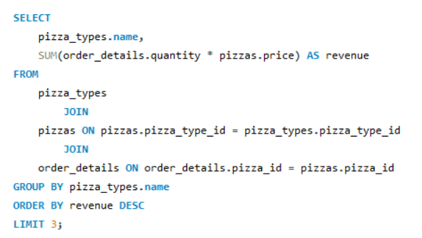
10. Determine the top 3 most ordered pizza types based on revenue.
< BACK
NEXT >

Slide 14
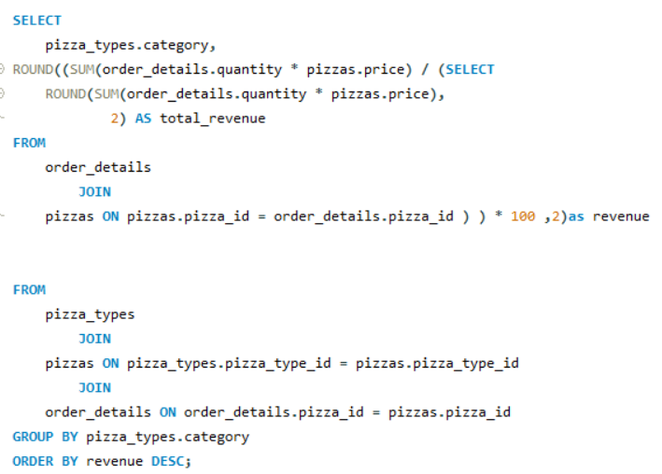
11. Calculate the percentage contribution of each pizza type to total revenue.
< BACK
NEXT >

Slide 15
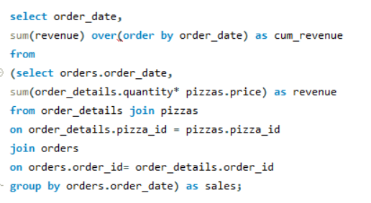
12. Analyze the cumulative revenue generated over time.
< BACK
NEXT >

Slide 16
13. Determine the top 3 most ordered pizza types based on revenue for each pizza category.
< BACK
NEXT >

Slide 17
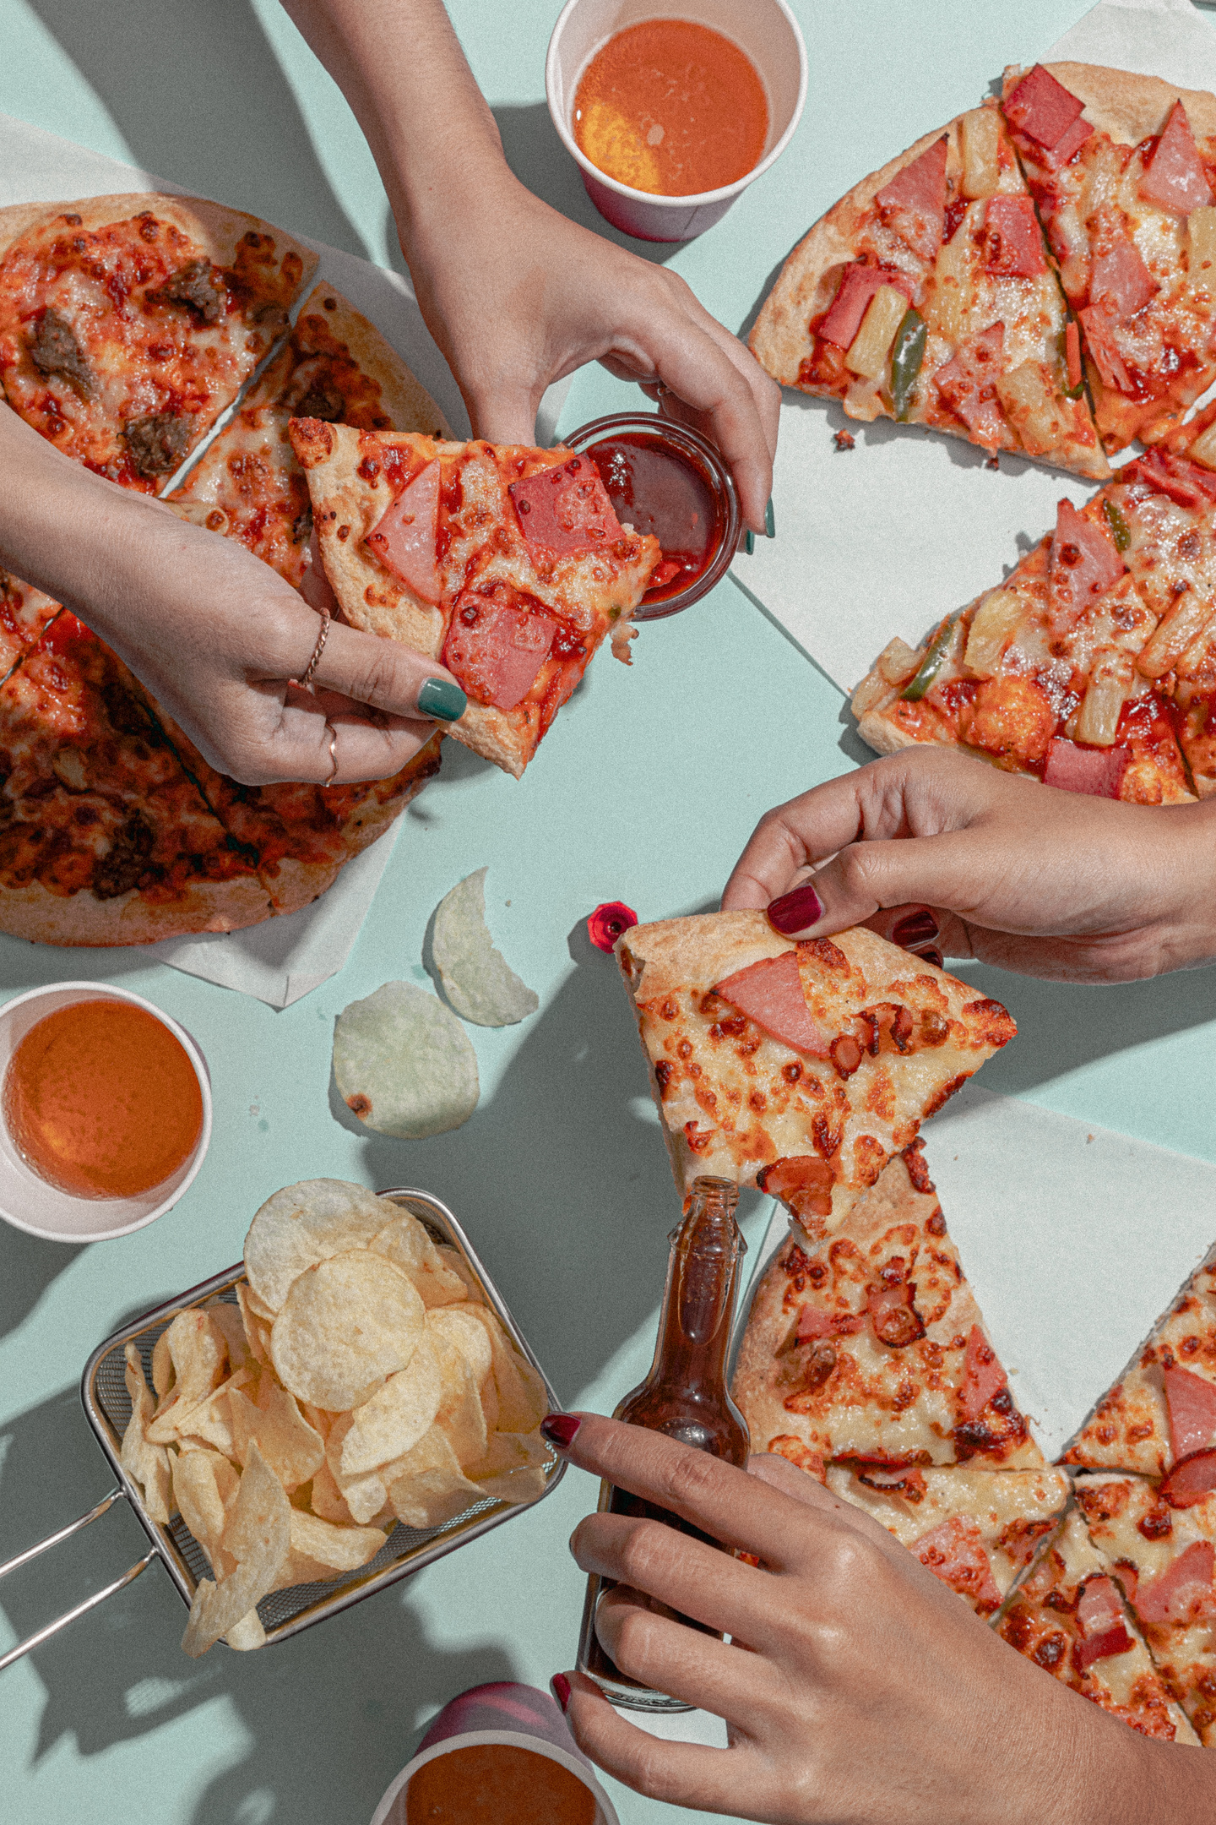

“SHARING IS CARING”
< BACK
NEXT >

Slide 18
THANK YOU!
< BACK

